Slide 1


Ultron
Product Walkthrough
From a planned change to a closed one
October 2026
Version 3
Internal use only

Slide 2
Ultron
Product Walkthrough
From a planned change to a closed one
October 2026
Version 3
Internal use only

Slide 3
Overview
The journey at a glance
Eight steps take a plan from the Plans list to its outcome. The slides that follow walk through each one.
01
02
03
04
05
06
07
08
Find your work
Create the plan
Add items
Submit and validate
Wait for the window
Run and monitor
Handle exceptions
See the outcome
Open Plans and pick up what needs you
Choose each target and check its impact
Name it, pick the operation, link the change
The system checks the plan and every item
Validated and waiting for the change window
Items run in parallel; follow the progress
Decide on any task that stops
Completed, or completed with failures
Internal use only

Slide 4
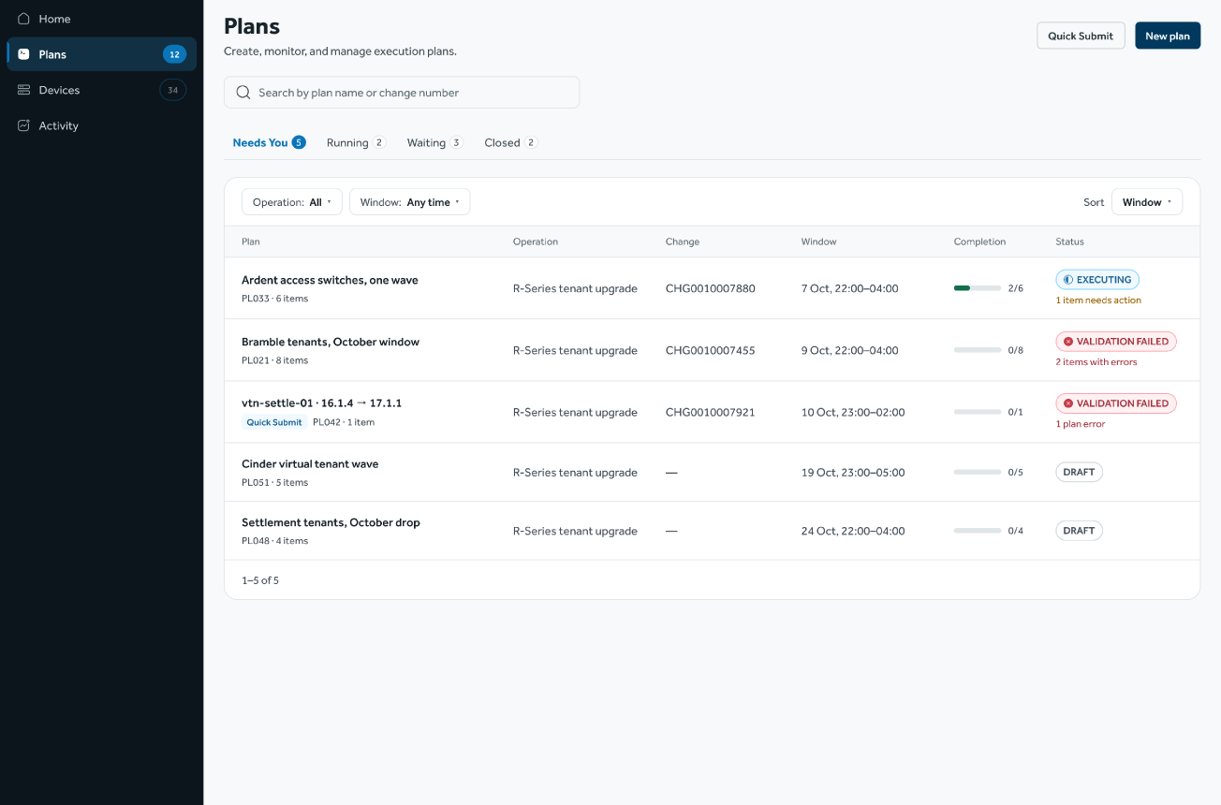
Create the plan
Start with a new plan
Name the plan, choose the operation and link the change record. One plan holds one operation and one change window.
STEP 1 OF 8
Find your work
Create the plan
Add items
Submit and validate
Wait for the window
Run and monitor
Handle exceptions
See the outcome
Internal use only

Slide 5
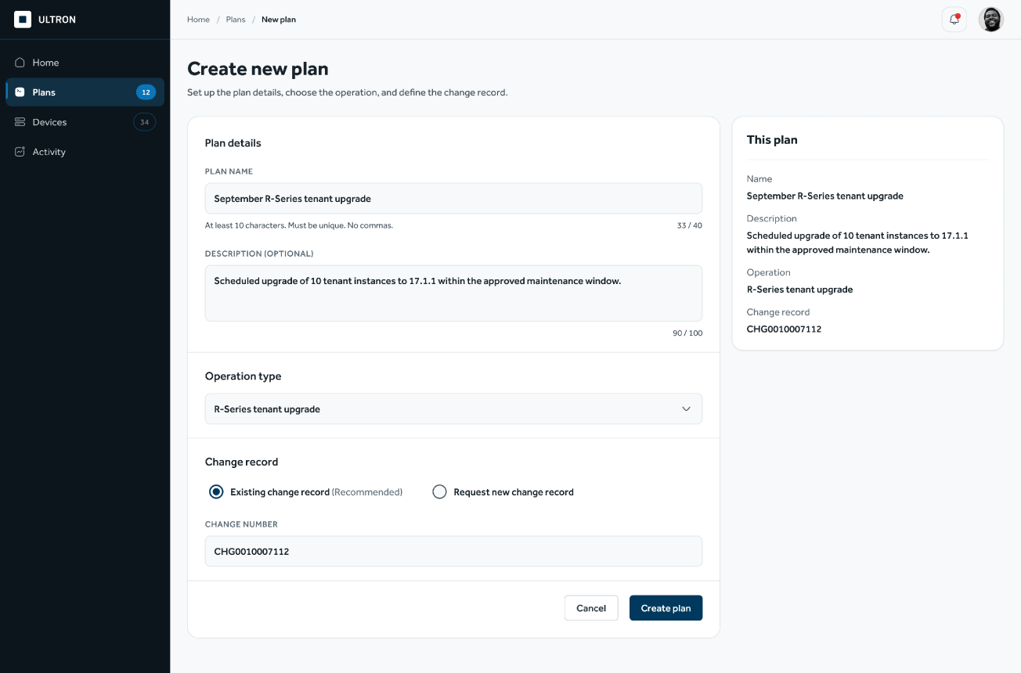
Create the plan
Start with a new plan
Name the plan, choose the operation and link the change record. One plan holds one operation and one change window.
STEP 2 OF 8
Find your work
Create the plan
Add items
Submit and validate
Wait for the window
Run and monitor
Handle exceptions
See the outcome
Internal use only

Slide 6
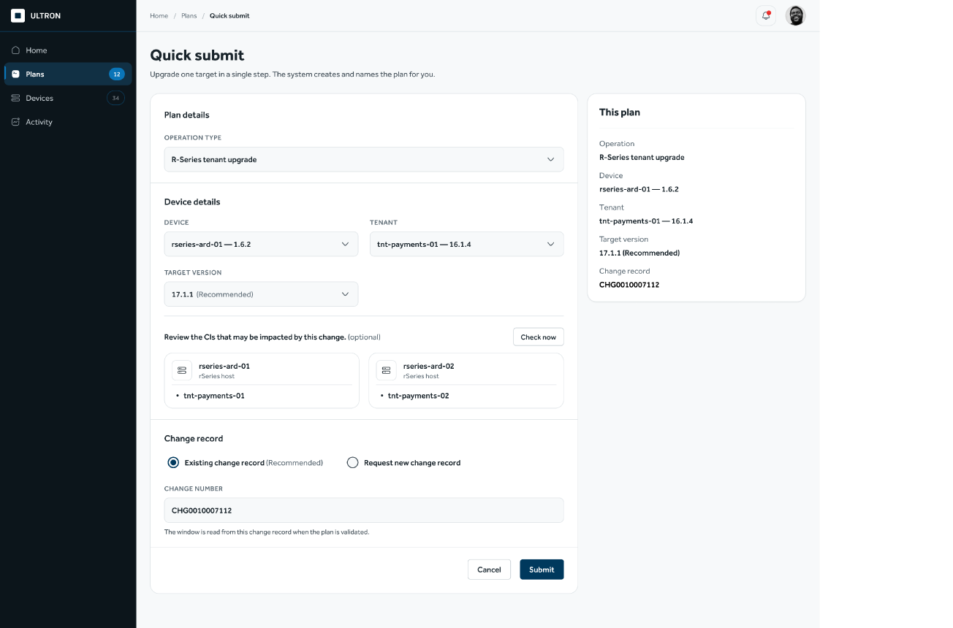
Create the plan
Quick Submit for a single change
For one target, the same checks happen on a single screen. The system creates the plan in the background.
STEP 2 OF 8
Find your work
Create the plan
Add items
Submit and validate
Wait for the window
Run and monitor
Handle exceptions
See the outcome
Internal use only

Slide 7
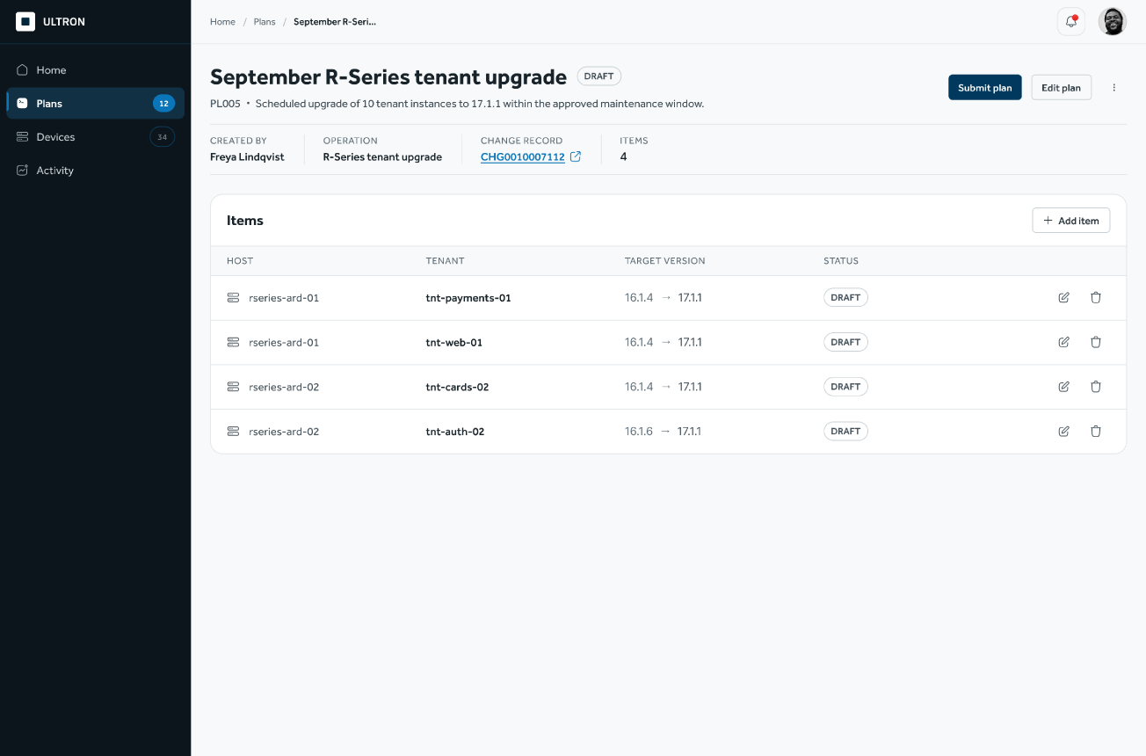
Add items
The plan opens as a draft
Add the targets one by one. Nothing runs until the plan is submitted, so the draft can be changed freely.
STEP 3 OF 8
Find your work
Create the plan
Add items
Submit and validate
Wait for the window
Run and monitor
Handle exceptions
See the outcome
Internal use only

Slide 8
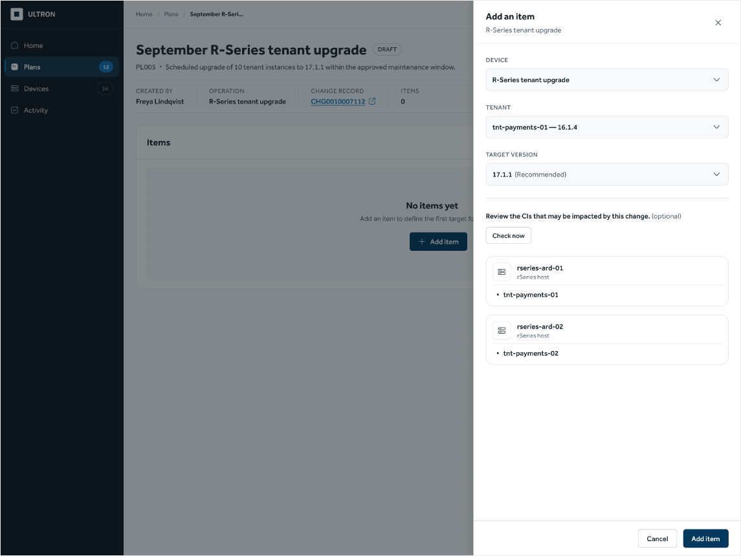
Add items
Add an item and see its impact
Choose the device, tenant and target version. The impact check lists everything the change touches before the item is added.
STEP 3 OF 8
Find your work
Create the plan
Add items
Submit and validate
Wait for the window
Run and monitor
Handle exceptions
See the outcome
Internal use only

Slide 9
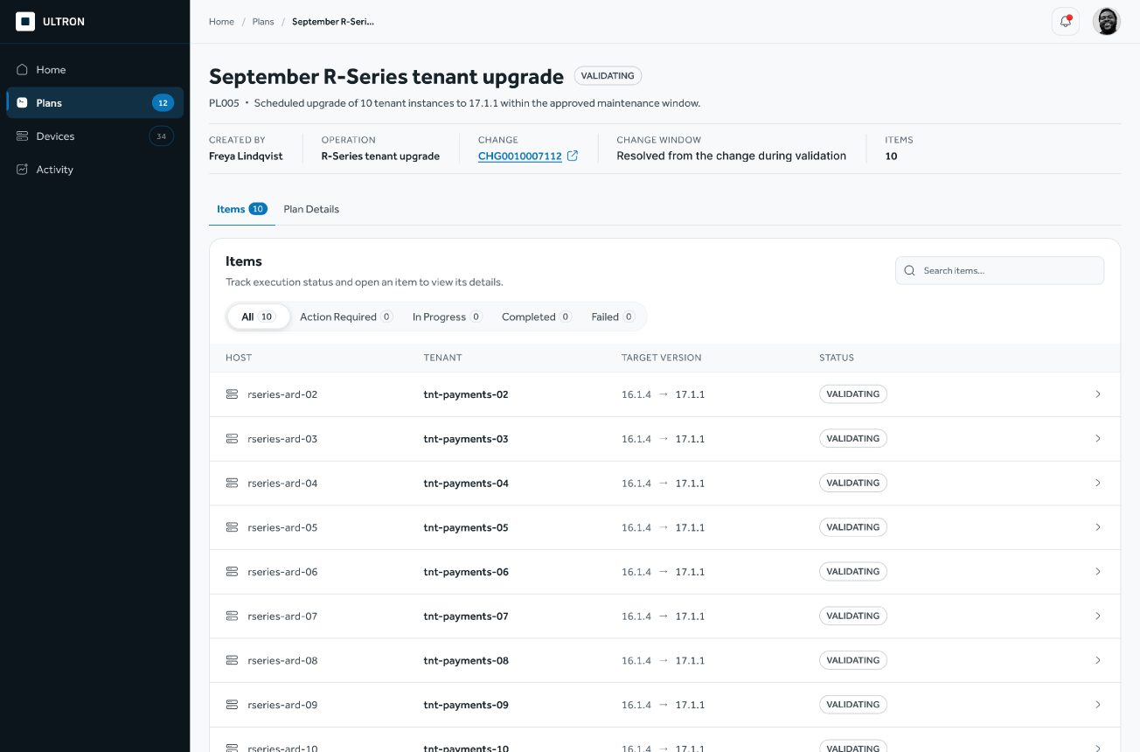
Submit and validate
Submit, and the system checks it
The plan details and every item are validated. If anything is wrong, the plan comes back with the errors marked, ready to fix.
STEP 4 OF 8
Find your work
Create the plan
Add items
Submit and validate
Wait for the window
Run and monitor
Handle exceptions
See the outcome
Internal use only

Slide 10
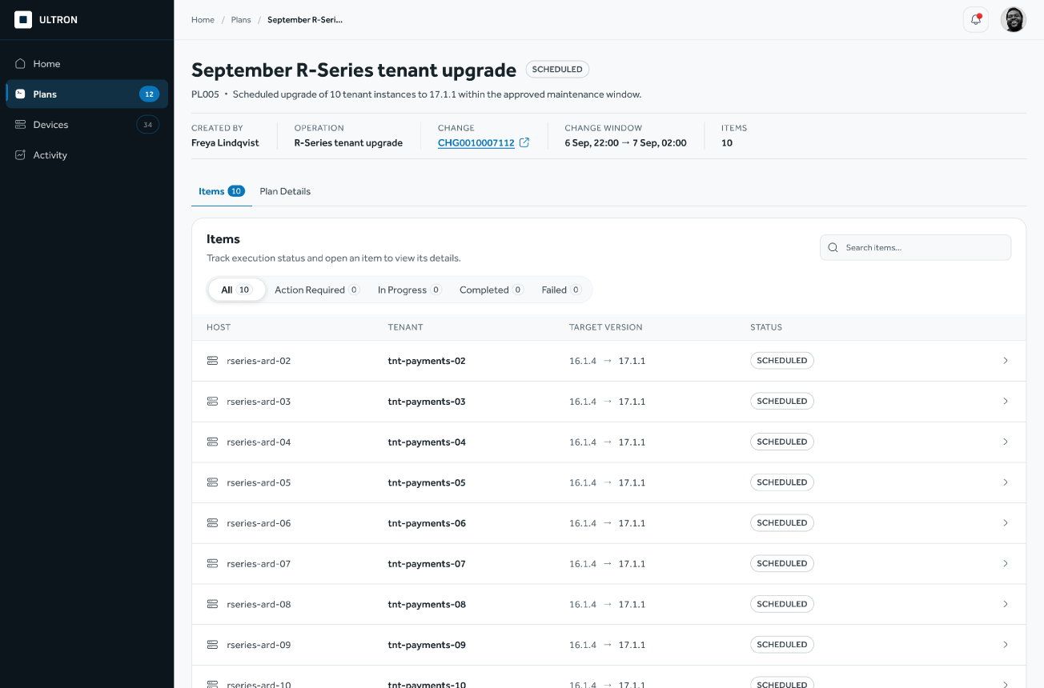
Wait for the window
Scheduled until the window opens
Validation passed and the change record is in place. The plan waits for its change window.
STEP 5 OF 8
Find your work
Create the plan
Add items
Submit and validate
Wait for the window
Run and monitor
Handle exceptions
See the outcome
Internal use only

Slide 11
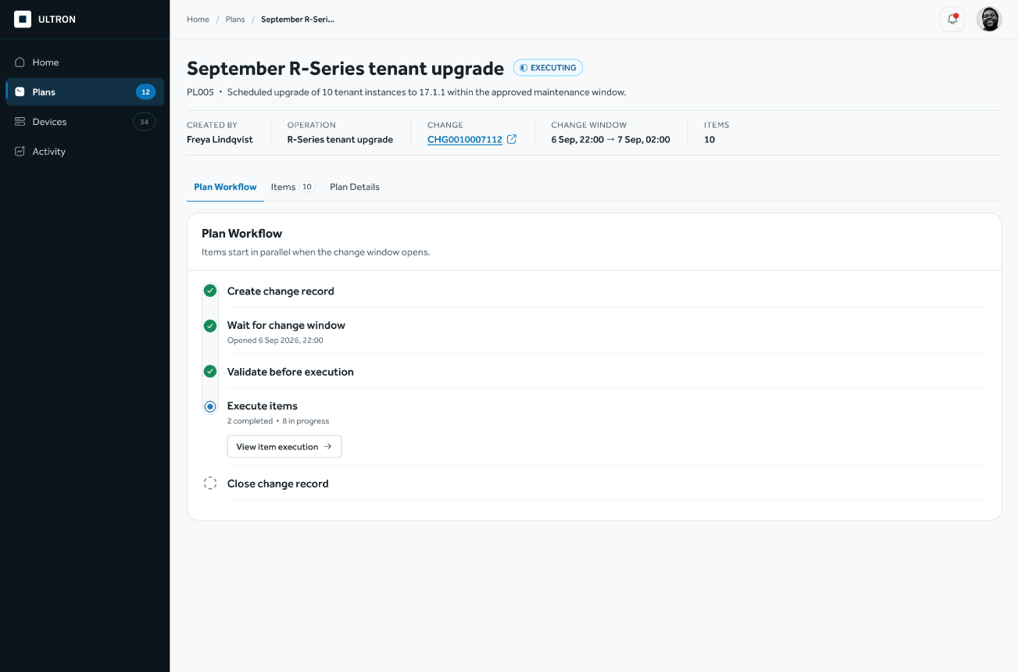
Run and monitor
The plan runs when the window opens
The plan workflow starts and items run in parallel. Each step shows where the plan stands.
STEP 6 OF 8
Find your work
Create the plan
Add items
Submit and validate
Wait for the window
Run and monitor
Handle exceptions
See the outcome
Internal use only

Slide 12
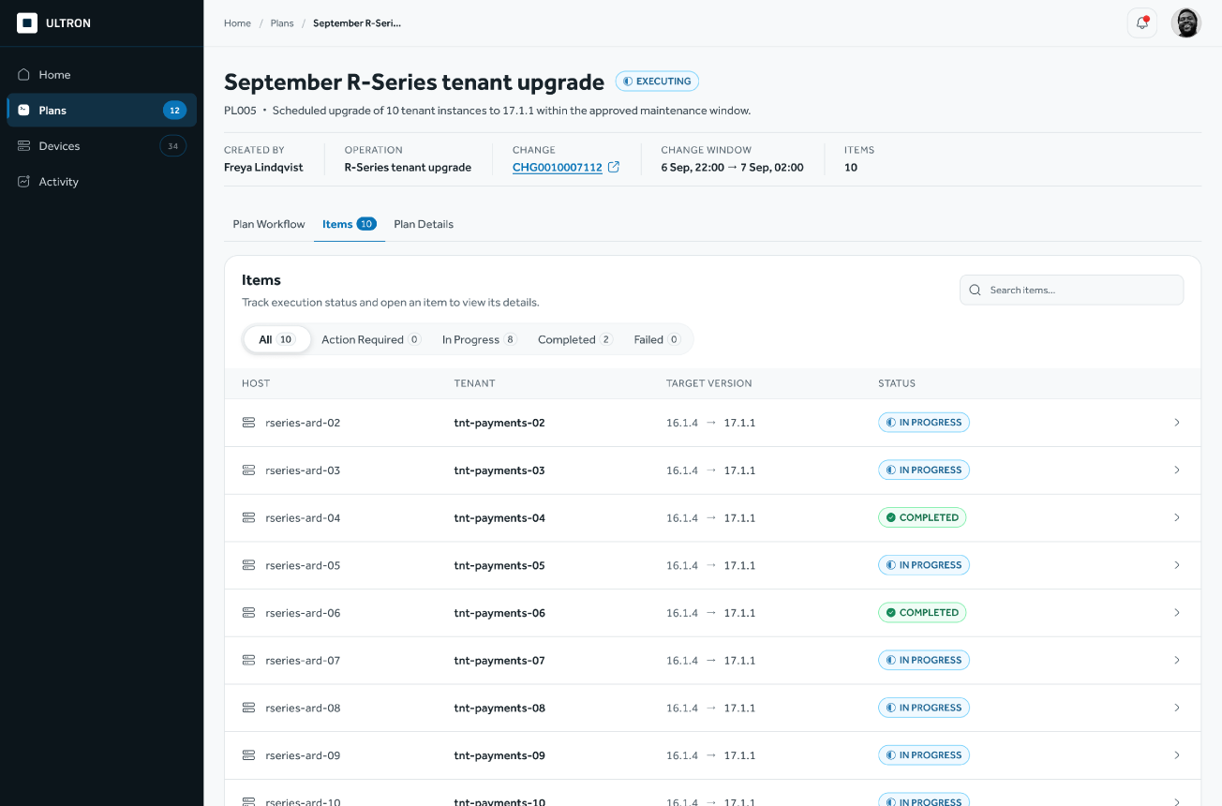
Run and monitor
Every item at a glance
Filter by what needs action, what failed, what is running and what is done. Open any item for its detail.
STEP 6 OF 8
Find your work
Create the plan
Add items
Submit and validate
Wait for the window
Run and monitor
Handle exceptions
See the outcome
Internal use only

Slide 13
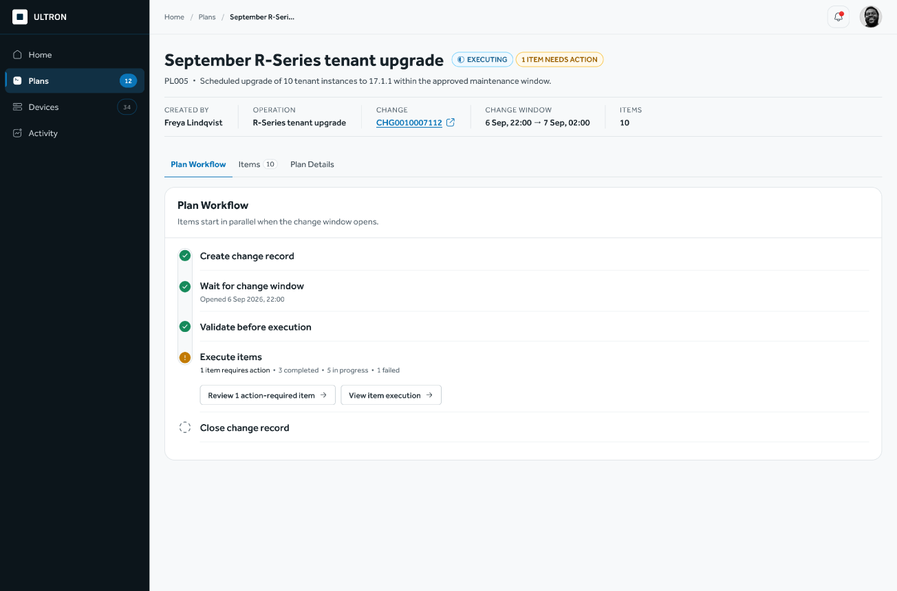
Handle exceptions
One item needs a decision
The plan keeps running. The item that stopped is called out, one click away from its detail.
STEP 7 OF 8
Find your work
Create the plan
Add items
Submit and validate
Wait for the window
Run and monitor
Handle exceptions
See the outcome
Internal use only

Slide 14
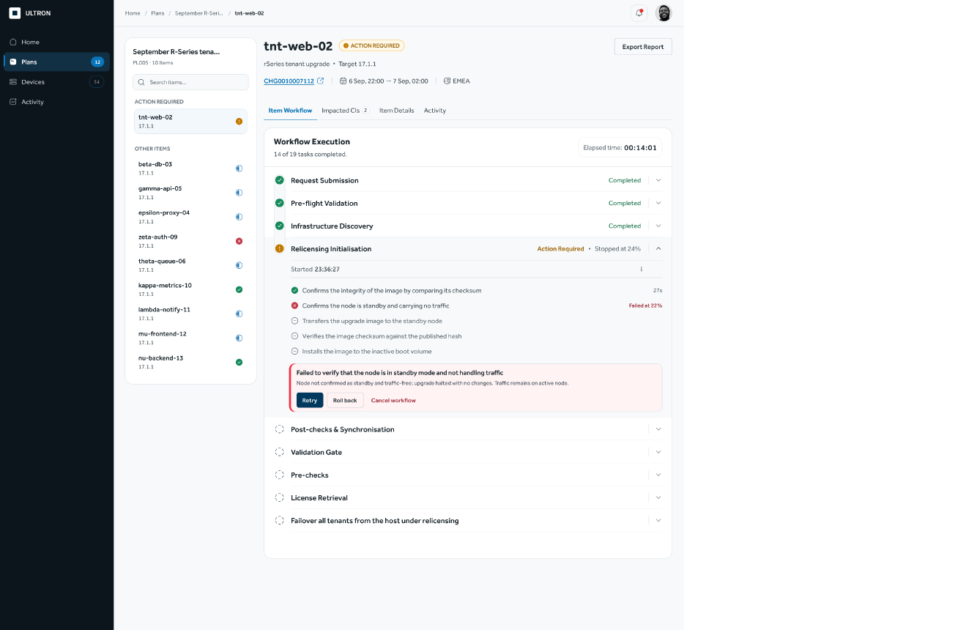
Handle exceptions
Everything needed to decide
The stopped task shows where and why it failed. The operator chooses Retry, Roll back or Cancel.
STEP 7 OF 8
Find your work
Create the plan
Add items
Submit and validate
Wait for the window
Run and monitor
Handle exceptions
See the outcome
Internal use only

Slide 15
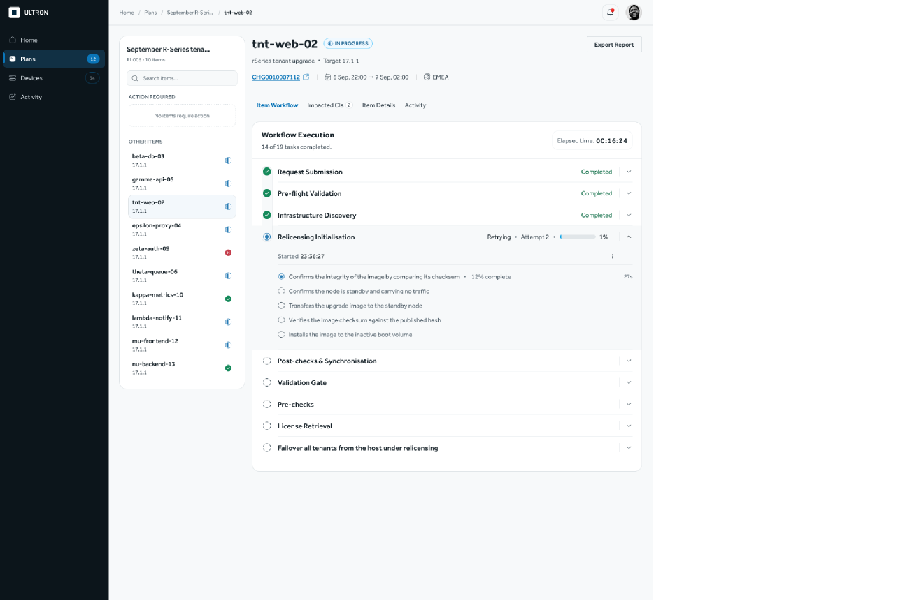
Handle exceptions
Retry runs the task again
Retry restarts the whole task from its first milestone, and the item returns to In Progress.
STEP 7 OF 8
Find your work
Create the plan
Add items
Submit and validate
Wait for the window
Run and monitor
Handle exceptions
See the outcome
Internal use only

Slide 16
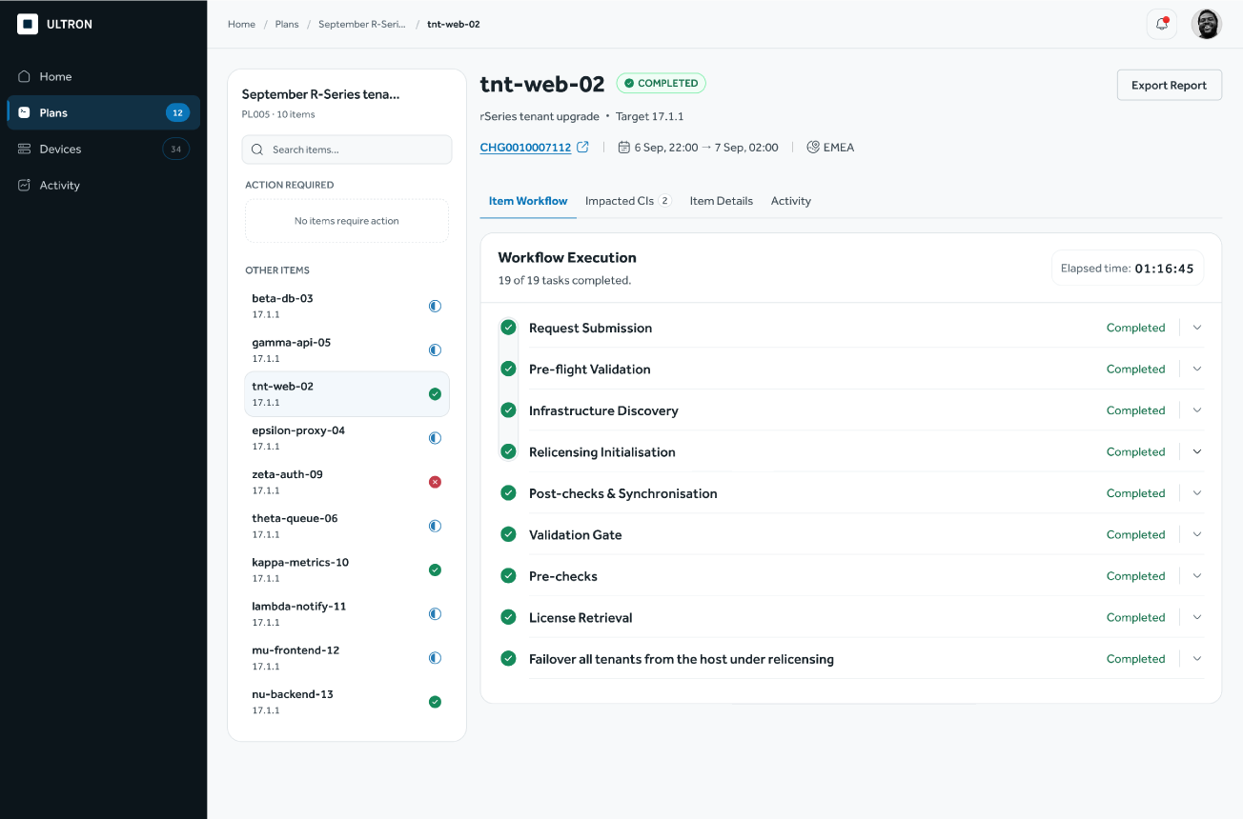
See the outcome
The item completes
Every task has finished and the item is marked Completed.
STEP 8 OF 8
Find your work
Create the plan
Add items
Submit and validate
Wait for the window
Run and monitor
Handle exceptions
See the outcome
Internal use only

Slide 17
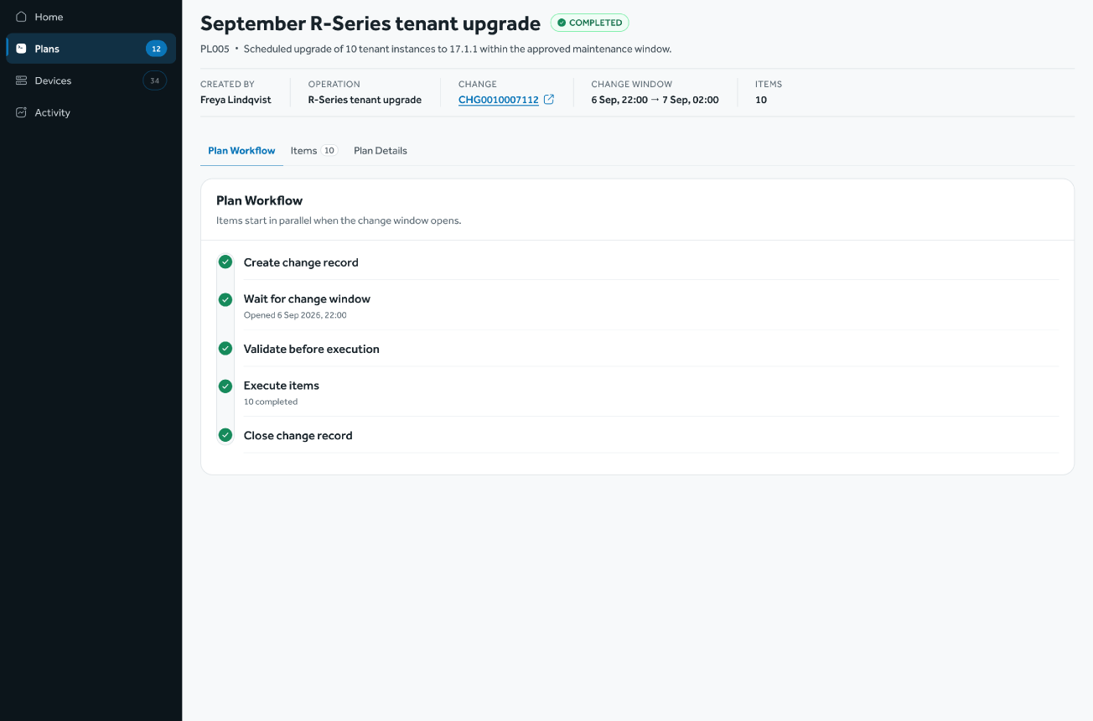
See the outcome
The plan closes
When every item has finished, the change record is closed and the plan shows its outcome.
STEP 8 OF 8
Find your work
Create the plan
Add items
Submit and validate
Wait for the window
Run and monitor
Handle exceptions
See the outcome
Internal use only

Slide 18
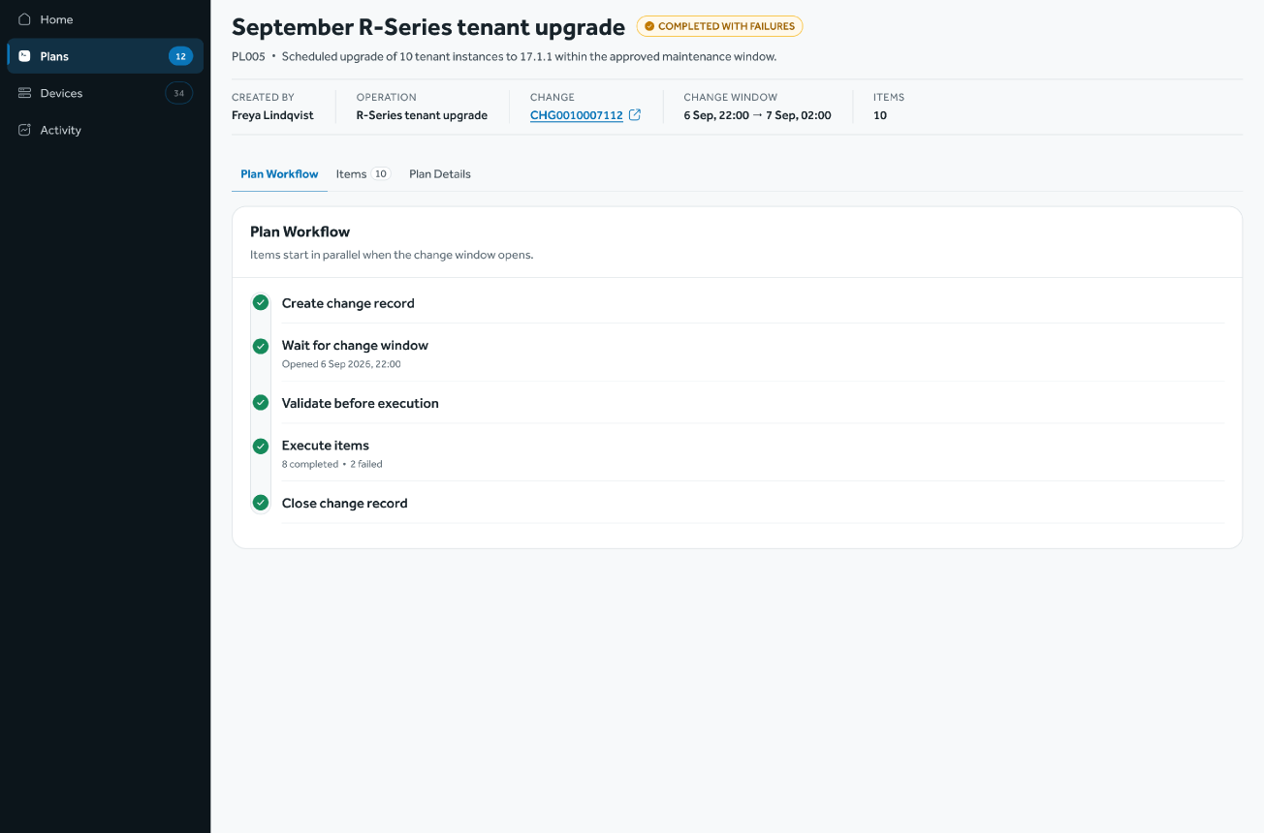
See the outcome
When not every item succeeds
The plan finishes as Completed with failures. The Items tab shows exactly which items did not complete.
STEP 8 OF 8
Find your work
Create the plan
Add items
Submit and validate
Wait for the window
Run and monitor
Handle exceptions
See the outcome
Internal use only

Slide 19

Thank you
Questions and feedback welcome.
Internal use only

Slide 20
Overview
The journey at a glance
Eight steps take a plan from the Plans list to its outcome. The slides that follow walk through each one.
01
02
03
04
05
06
07
08
Find your work
Create the plan
Add items
Submit and validate
Wait for the window
Run and monitor
Handle exceptions
See the outcome
Open Plans and pick up what needs you
Choose each target and check its impact
Name it, pick the operation, link the change
The system checks the plan and every item
Validated and waiting for the change window
Items run in parallel; follow the progress
Decide on any task that stops
Completed, or completed with failures
Internal use only

Slide 21
Create the plan
Start with a new plan
Name the plan, choose the operation and link the change record. One plan holds one operation and one change window.
STEP 1 OF 8
Find your work
Create the plan
Add items
Submit and validate
Wait for the window
Run and monitor
Handle exceptions
See the outcome
Internal use only

Slide 22
Create the plan
Start with a new plan
Name the plan, choose the operation and link the change record. One plan holds one operation and one change window.
STEP 2 OF 8
Find your work
Create the plan
Add items
Submit and validate
Wait for the window
Run and monitor
Handle exceptions
See the outcome
Internal use only

Slide 23
Create the plan
Quick Submit for a single change
For one target, the same checks happen on a single screen. The system creates the plan in the background.
STEP 2 OF 8
Find your work
Create the plan
Add items
Submit and validate
Wait for the window
Run and monitor
Handle exceptions
See the outcome
Internal use only

Slide 24
Add items
The plan opens as a draft
Add the targets one by one. Nothing runs until the plan is submitted, so the draft can be changed freely.
STEP 3 OF 8
Find your work
Create the plan
Add items
Submit and validate
Wait for the window
Run and monitor
Handle exceptions
See the outcome
Internal use only

Slide 25
Add items
Add an item and see its impact
Choose the device, tenant and target version. The impact check lists everything the change touches before the item is added.
STEP 3 OF 8
Find your work
Create the plan
Add items
Submit and validate
Wait for the window
Run and monitor
Handle exceptions
See the outcome
Internal use only

Slide 26
Submit and validate
Submit, and the system checks it
The plan details and every item are validated. If anything is wrong, the plan comes back with the errors marked, ready to fix.
STEP 4 OF 8
Find your work
Create the plan
Add items
Submit and validate
Wait for the window
Run and monitor
Handle exceptions
See the outcome
Internal use only

Slide 27
Wait for the window
Scheduled until the window opens
Validation passed and the change record is in place. The plan waits for its change window.
STEP 5 OF 8
Find your work
Create the plan
Add items
Submit and validate
Wait for the window
Run and monitor
Handle exceptions
See the outcome
Internal use only

Slide 28
Run and monitor
The plan runs when the window opens
The plan workflow starts and items run in parallel. Each step shows where the plan stands.
STEP 6 OF 8
Find your work
Create the plan
Add items
Submit and validate
Wait for the window
Run and monitor
Handle exceptions
See the outcome
Internal use only

Slide 29
Run and monitor
Every item at a glance
Filter by what needs action, what failed, what is running and what is done. Open any item for its detail.
STEP 6 OF 8
Find your work
Create the plan
Add items
Submit and validate
Wait for the window
Run and monitor
Handle exceptions
See the outcome
Internal use only

Slide 30
Handle exceptions
One item needs a decision
The plan keeps running. The item that stopped is called out, one click away from its detail.
STEP 7 OF 8
Find your work
Create the plan
Add items
Submit and validate
Wait for the window
Run and monitor
Handle exceptions
See the outcome
Internal use only

Slide 31
Handle exceptions
Everything needed to decide
The stopped task shows where and why it failed. The operator chooses Retry, Roll back or Cancel.
STEP 7 OF 8
Find your work
Create the plan
Add items
Submit and validate
Wait for the window
Run and monitor
Handle exceptions
See the outcome
Internal use only

Slide 32
Handle exceptions
Retry runs the task again
Retry restarts the whole task from its first milestone, and the item returns to In Progress.
STEP 7 OF 8
Find your work
Create the plan
Add items
Submit and validate
Wait for the window
Run and monitor
Handle exceptions
See the outcome
Internal use only

Slide 33
See the outcome
The item completes
Every task has finished and the item is marked Completed.
STEP 8 OF 8
Find your work
Create the plan
Add items
Submit and validate
Wait for the window
Run and monitor
Handle exceptions
See the outcome
Internal use only

Slide 34
See the outcome
The plan closes
When every item has finished, the change record is closed and the plan shows its outcome.
STEP 8 OF 8
Find your work
Create the plan
Add items
Submit and validate
Wait for the window
Run and monitor
Handle exceptions
See the outcome
Internal use only

Slide 35
See the outcome
When not every item succeeds
The plan finishes as Completed with failures. The Items tab shows exactly which items did not complete.
STEP 8 OF 8
Find your work
Create the plan
Add items
Submit and validate
Wait for the window
Run and monitor
Handle exceptions
See the outcome
Internal use only

Slide 36

Thank you
Questions and feedback welcome.
Internal use only

